Slide 1

Netflix Dataset Analysis: Content Trends for Strategic Recommendations
[G. Jishnu Sai Reddy]
[INTERNSHIP_17546440516895be537820f]

Slide 2

PROBLEM STATEMENT
Netflix faces intense competition from Amazon Prime, Disney+, and regional OTT platforms. To maintain its market leadership, Netflix must strategically analyze its content catalog to identify strengths, gaps, and opportunities.
Core Problem: Content Trends Analysis for Strategic Recommendations
Focus Areas:
How has Netflix's content distribution (Movies vs. TV Shows) evolved from 2008-2021?
Which genres dominate the platform and how have preferences shifted?
What is the country-wise contribution to Netflix's global catalog?

Slide 3
Project Description
This project performs comprehensive data analysis on Netflix's catalog containing 7,789 records across 11 attributes including title, director, cast, country, release date, rating, duration, and genres.
Key Analysis Components:
Temporal Analysis: Distribution trends of Movies and TV Shows over 13+ years
Genre Analysis: Identification of popular genres and emerging content categories
Geographic Analysis: Country-wise content contribution and global representation patterns
Strategic Insights: Data-driven recommendations for content acquisition and production strategies
Dataset Coverage: 2008-2021 spanning multiple countries and diverse genres

Slide 4

WHO ARE THE END USERS?
Primary Users:
Netflix Content Strategy Teams: For content acquisition and production planning
Business Analysts: To understand market trends and competitive positioning
Marketing Teams: For audience segmentation and targeted campaigns
Secondary Users:
Content Creators & Production Houses: Understanding platform preferences
Investors & Stakeholders: Evaluating Netflix's content strategy effectiveness
Academic Researchers: Studying OTT platform evolution and consumer behavior

Slide 5

Technology Used
Programming Language: Python
Key Libraries:
Pandas: Data manipulation and cleaning
NumPy: Numerical computations
Matplotlib/Seaborn: Data visualization and trend analysis
Plotly: Interactive visualizations
Development Environment: Jupyter Notebook / Google Colab
Version Control: Git & GitHub
Data Processing: CSV file handling, data preprocessing, missing value treatment

Slide 6
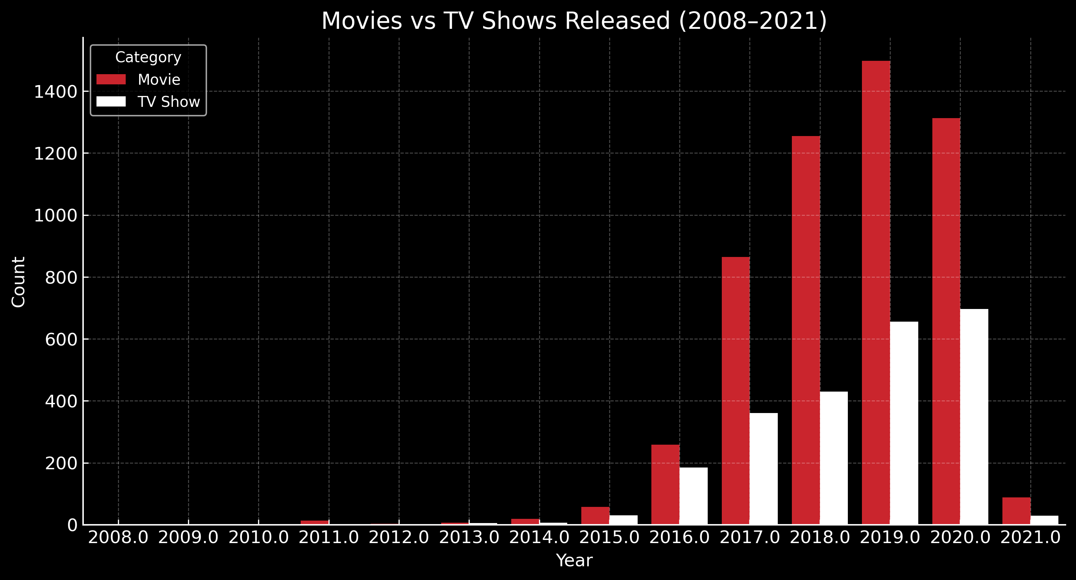
RESULTS1
[Add screen shots of your code or Chart(s) ]

Slide 7
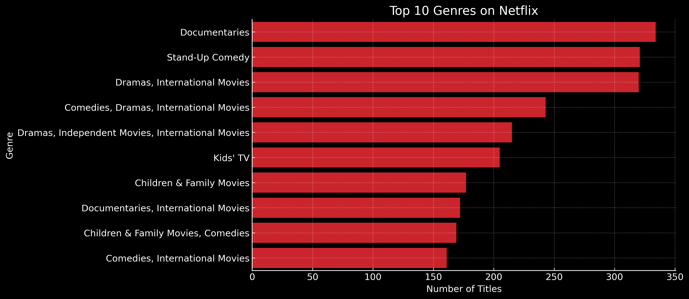
RESULTS2
[Add screen shots of your code or Chart(s) ]

Slide 8
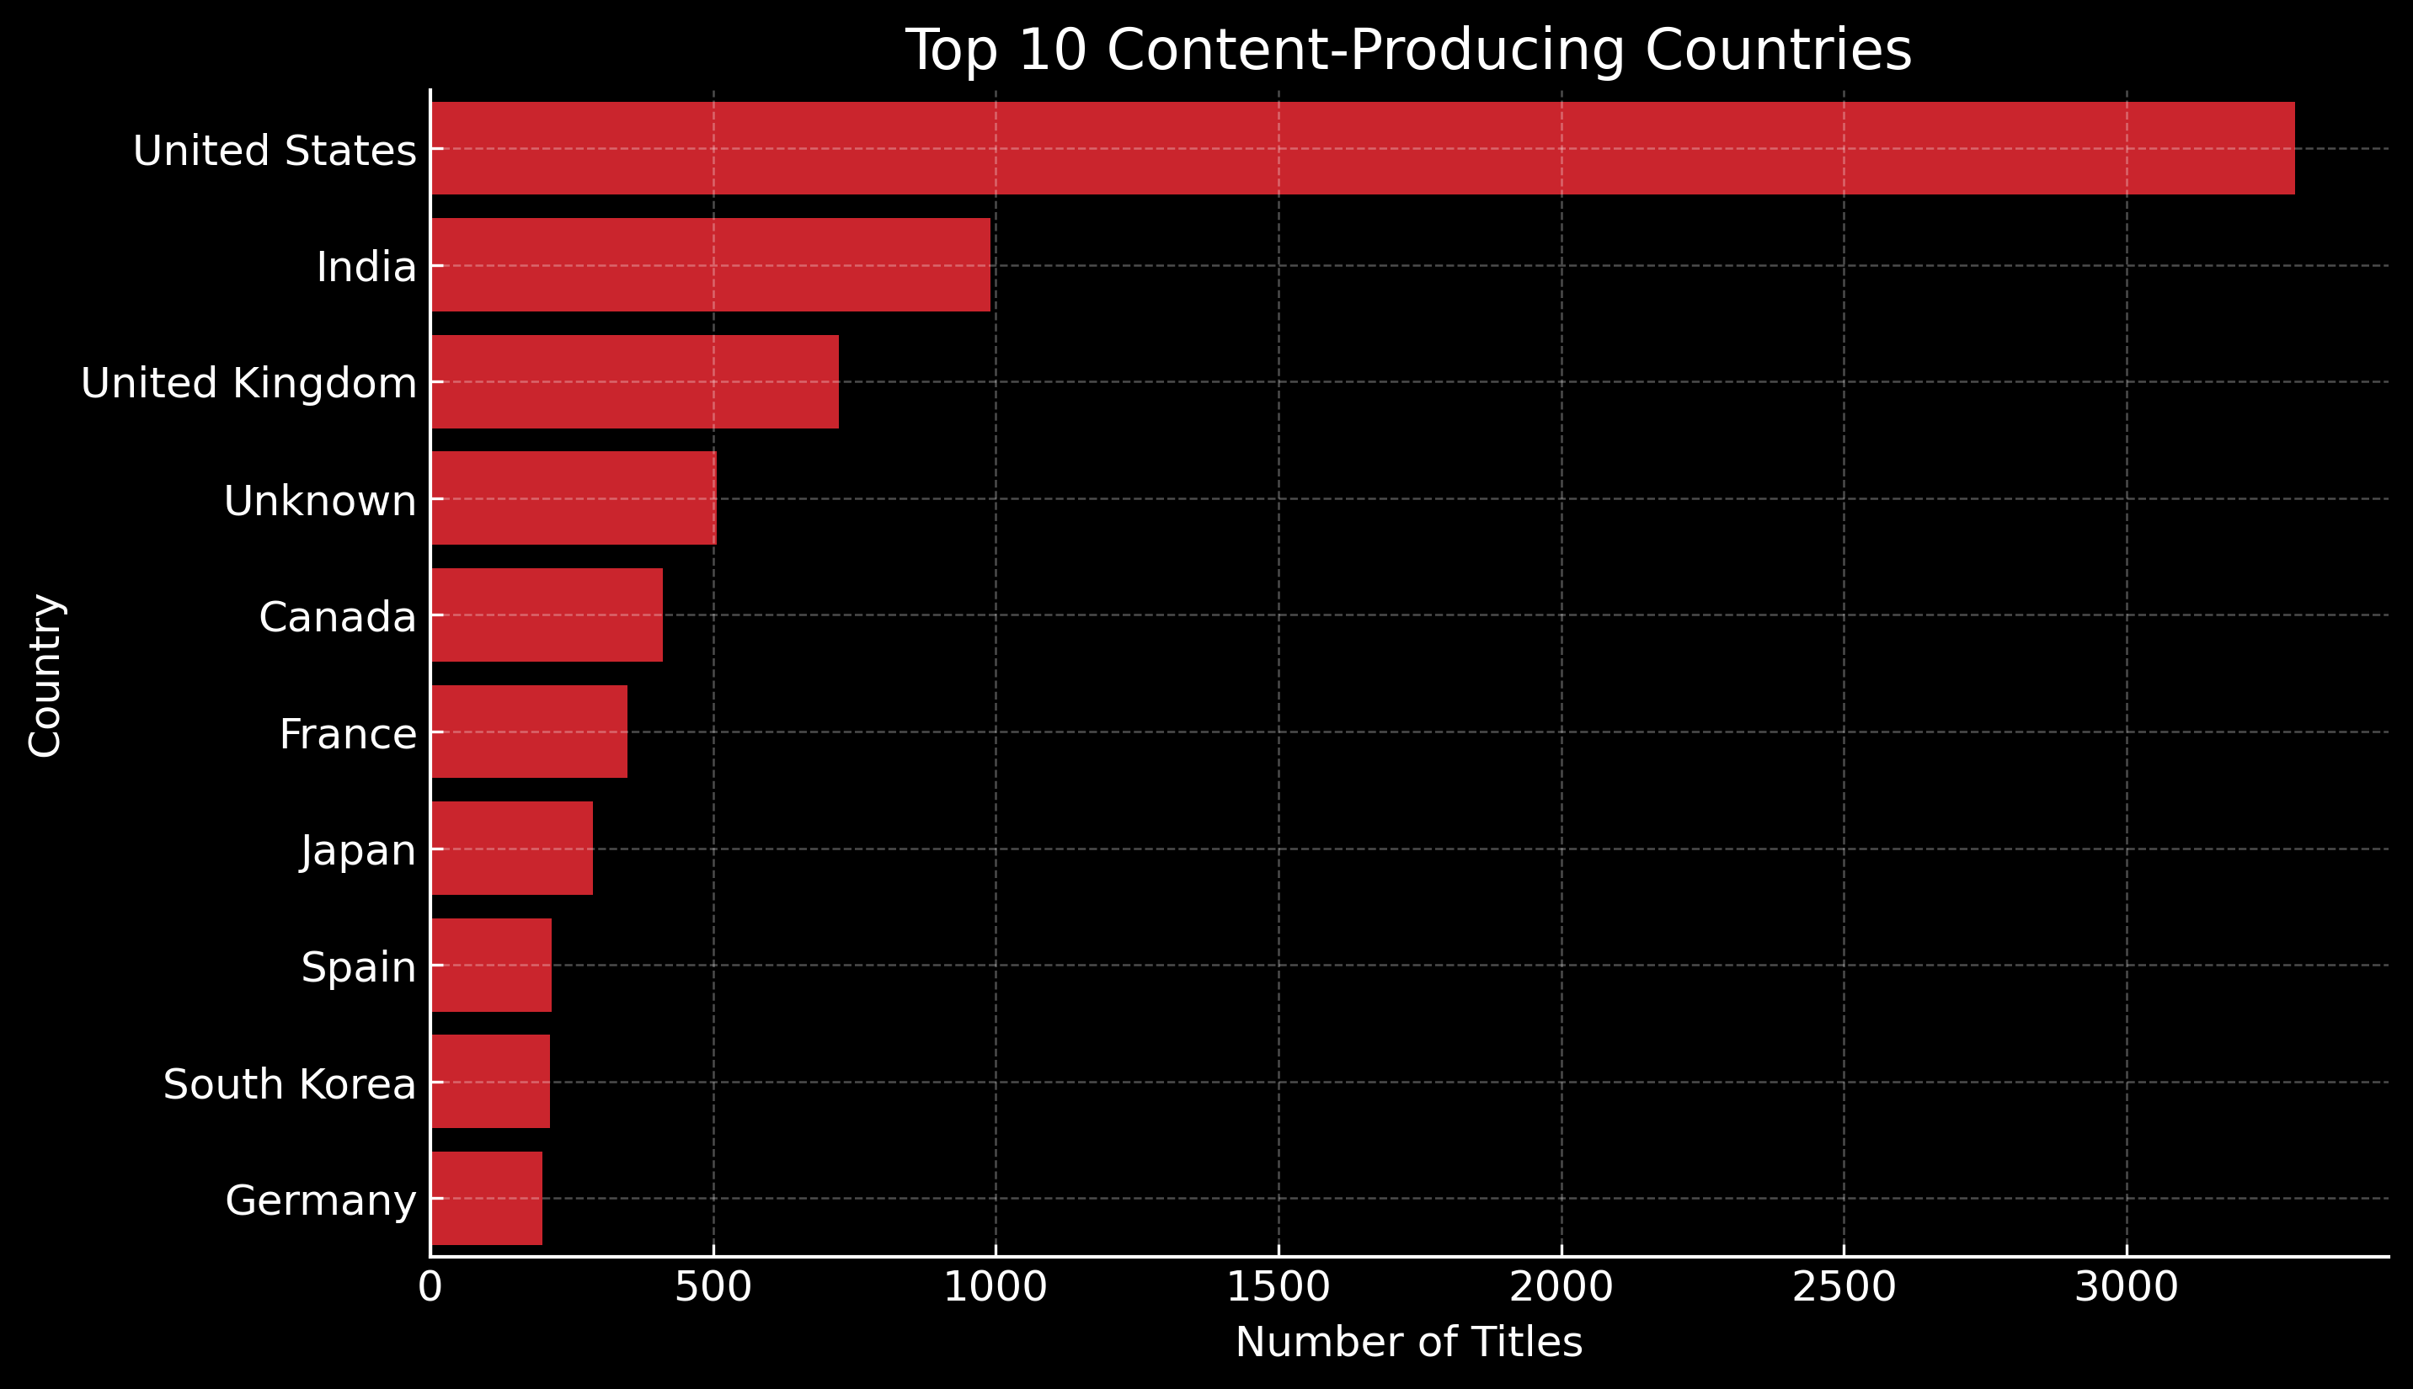
RESULTS3
[Add screen shots of your code or Chart(s) ]

Slide 9
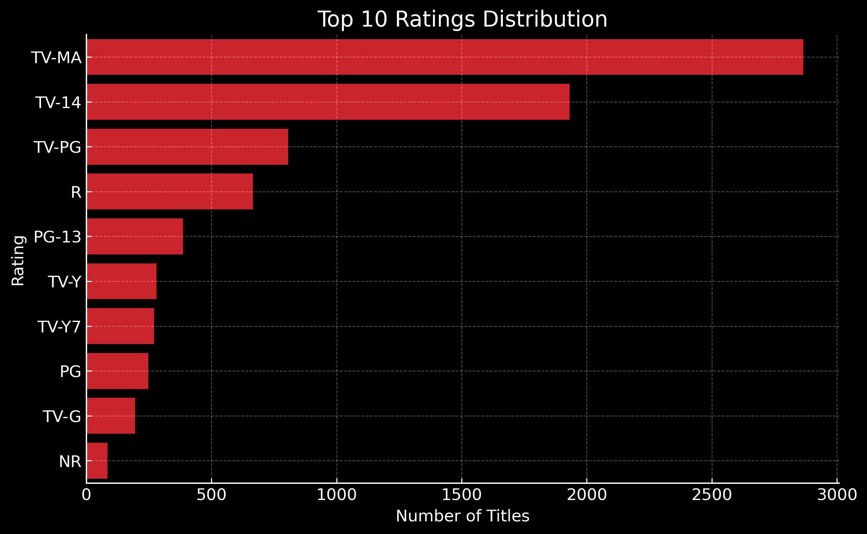
RESULTS4
[Add screen shots of your code or Chart(s) ]

Slide 10
GitHub repository

Slide 11
Getting started with Basics of Python Certificate
[Paste your Certificate Here]

Slide 12
Data Visualization Certificate
[Paste your Certificate Here]

Slide 13
Thank you
.
.

